Slide 1
Eniac- electronic numerical integrator and computer
By michaela healy and kevin dwyer

Slide 2

Contents
Introduction
Why it was invented.
Organization of Eniac
Who invented the Eniac.
How it was invented.
How the Eniac benefited people
What the eniac led to in computing today
Conclusion
References

Slide 3
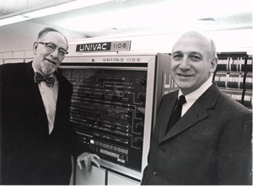
Background of Eniac/ Introduction to the eniac
It was built by John Mauchly and J. Presper Eckert at the University of Pennsylvania.
Officially presented to the public on February 15th 1946.
It was used to be a secret World War II project.
They used it to speed up mathematical calculations in order of producing artillery firing tables for the army.
The ENIAC was used until 1955
John Mauchly & John Presper Eckert

Slide 4
Why Was The Eniac Invented
The Eniac was the world’s first large scale digital electronic general purpose computer.
It was designed to be capable of being reprogrammed to solve a large number of numerical problems.
the engineers in the University were picked for the US army for computation, long guns and firing tables.

Slide 5
Organization of Eniac
Engineers Ideas
ENIAC
Solve Numerical Problems
Speed Up Mathematical Calculations
Produce Artillery Firing Tables

Slide 6
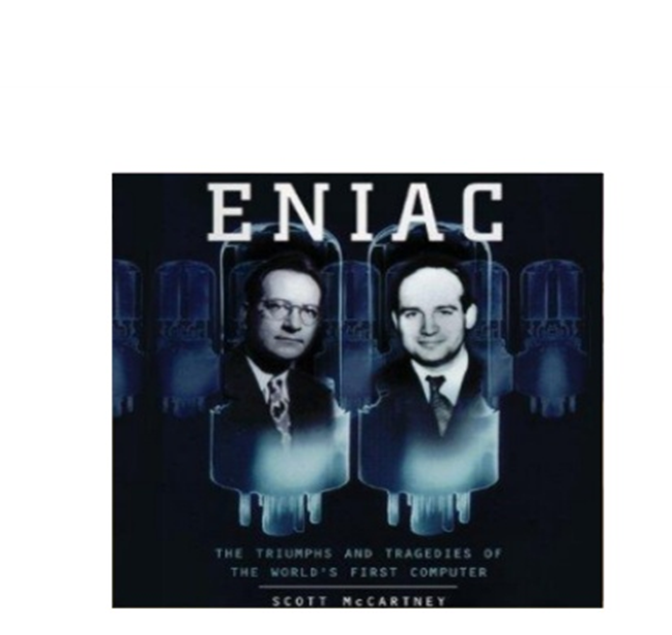
Who Invented The Eniac
It was built by John Mauchly and J. Presper Eckert.
Eckert was born in Philadelphia and Mauchly was born in Ohio.
They both started the first computer company, the Eckert – Mauchly Computer Corporation (EMCC).
Both men were interested in speeding up the ability to perform computations.

Slide 7
Construction-How The Eniac Was Invented
The ENIAC took 2 years to be built from 1943-1945 before being presented in 1946
It consisted of 17,468 vacuum tubes, 70,000 resistors, 6,000 manual switches and 1,500 relays
It covered 1800 square feet of floor space and weighed 30 tonnes.
The ENIAC was not originally designed as an internally programmed computer. The program was set up manually by varying switches and cable connections.

Slide 8
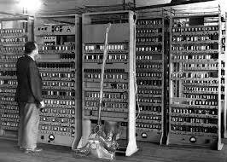
Doctor John Von Neumann
In 1948, the Eniac was having programming problems caused by them concurrently performing arithmetic and transfer operations.
John Von Neumann was a mathematician and he made several modifications to the machine
He suggested that they switch the central code selection so that their pluggable cable connections could remain fixed.
He also enabled their serial operation by adding a convertor code.
He was certainly a major help to the success of Eniac.

Slide 9
HOW THE ENIAC INSPIRED COMPUTING TODAY
The ENIAC computer played an extremely important role in the history of electronic computers.
Without the Eniac we wouldn’t have google today or the computer devices we have today.

Slide 10
Conclusion
The Eniac was invented at the University of Pennsylvania Moore School of Electrical Engineering.
It cost over $500,000 which is equivalent to 6 million dollars today.
Several tubes burned out almost every day, leaving it non functional about half the time.
The Eniac inspired the technology we have today.

Slide 11
References
https://theangrygentleman.wordpress.com/2009/10/18/random-eniac-facts/
https://msu.edu/course/jrn/108/Documents/Lectures/February%2024%20and%2026%20lectures%20on%20Computers%20spring%202003/sld008.htm
https://en.wikipedia.org/wiki/ENIAC
http://history-computer.com/ModernComputer/Electronic/ENIAC.html
https://www.youtube.com/watch?v=k4oGI_dNaPc
https://www.youtube.com/watch?v=bGk9W65vXNA
http://www.slideshare.net/markbrowning171/get-eniac-the-triumphs-and-tragedies-of-the-worlds-first-computer-full-audiobook?qid=e630f5d4-7110-449b-8ea7-148f3f95a459&v=&b=&from_search=3

